Slide 1
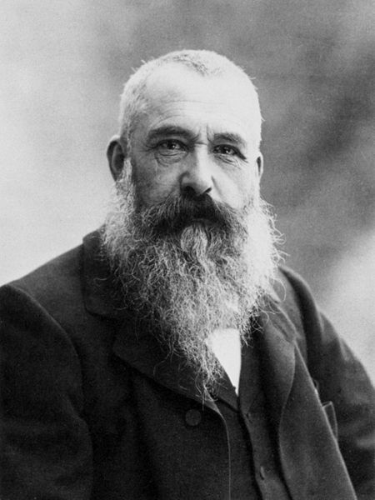
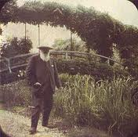
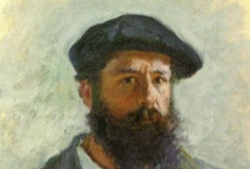
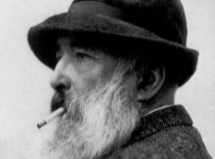
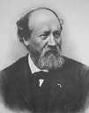
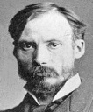
Claude Monet
Your name
Studied Art at Le Harve Secondary School of the arts * Lives in Giverny, France * Married * Born on November 14, 1840
Your name
Using our time in Giverny to paint “series” – these are images depicting the same subject at different times of day, in different kinds of light. Water lilies are my favorite! - with Eugene Boudin (Anderson, 75).
Eugene Boudin
Now that you’re living in Giverny, and you’re finally rich enough to purchase a house, land, and orchards, what are you painting?
Path to Fame
I always knew I wanted to be an artist. I attended the Le Harve secondary school of the arts, and made money selling charcoal sketches to locals. I also had drawing lessons from Jacques-Francois Ochard, and Eugene Boudin (Rita, par. 7).
Claude Monet
Working on a new painting: Impression, Sunrise – it’s a scene of the harbor at sunrise. I’m feeling great about it and think it might be a real winner! – with Frederic Bazille (Gascoigne, 4).
Frederic Bazille
What are you painting now? Up to anything new?
Friends
Eugene Boudin
Claude Monet
The new technique is working really well – using short brush strokes to capture the light looks great on canvas. They’re calling our style Impressionism – with Pieree-Auguste Renoir (Johnson, 2).
Pierre-Auguste Renoir
Pierre-Auguste Renoir
Loved working with you! How’s that new technique we developed working out?
Frederic Bazille

Slide 2
Claude Monet
Your Name
Your name
Studied Art at Le Harve Secondary School of the arts * Lives in Giverny, France * Married * Born on November 14, 1840
Basic Info
About Me
I’m one of the most influential Impressionist artist. I studied under a lot of other famous painters, but was probably most influenced by Manet (Johnson 2). In the beginning, my work was very unusual because my focus on unconventional compositions and bold colors was a big change from the Realist style popular at the time (Marcus 89). I love to watch the way light hits different objects and the way colors change depending on the sun and the time of day. I’m inspired by anything outdoors, but I especially love to garden. Water Lilies are one of my favorite things. My personal life hasn’t always been easy (Dudar 3). I was very poor at points, and both my wives, Camille and Alice, died before me (Anderson 1). I also lost my son, Jean. I hope I can inspire other painters to explore a more abstract style of work.
Friends
Philosophy
Eugene Boudin
Favorite
Quotations
“Just think of the illimitable abundance and the marvelous loveliness of light, or of the beauty of the sun and moon and stars.” – St. Augustine
Resources
Pierre-Auguste Renoir
Favorite
Frederic Bazille

Slide 3
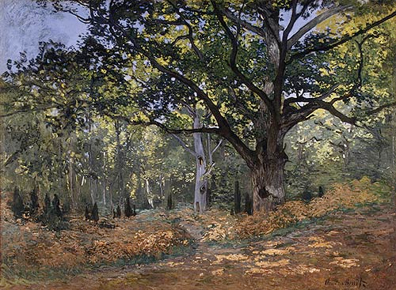
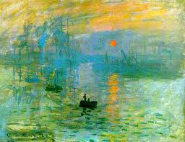
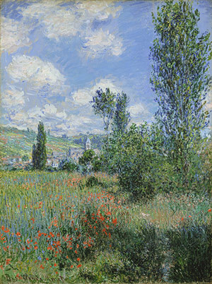
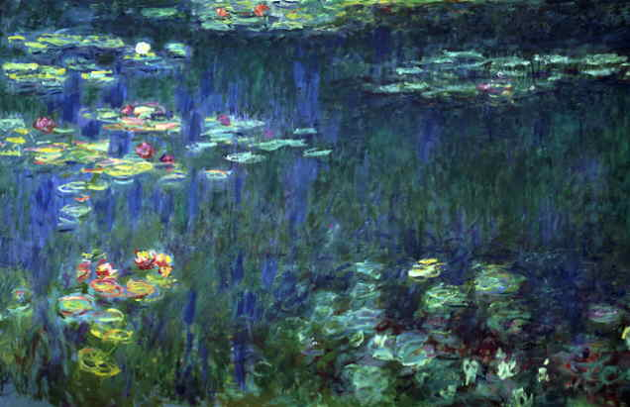
Claude Monet
My Memoir
By Your Name * Updated 1 day ago
Early Life
Story 1
Story 2
Story 3
Story 4

