Slide 1
Animal Farm Vocabulary

Slide 2
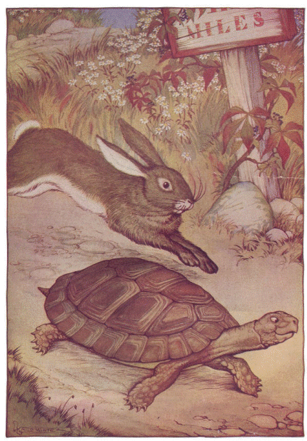
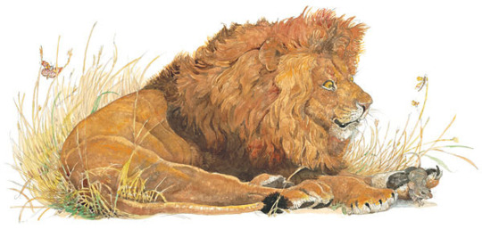
FABLE – a story with a moral [and often has talking animal characters]

Slide 3
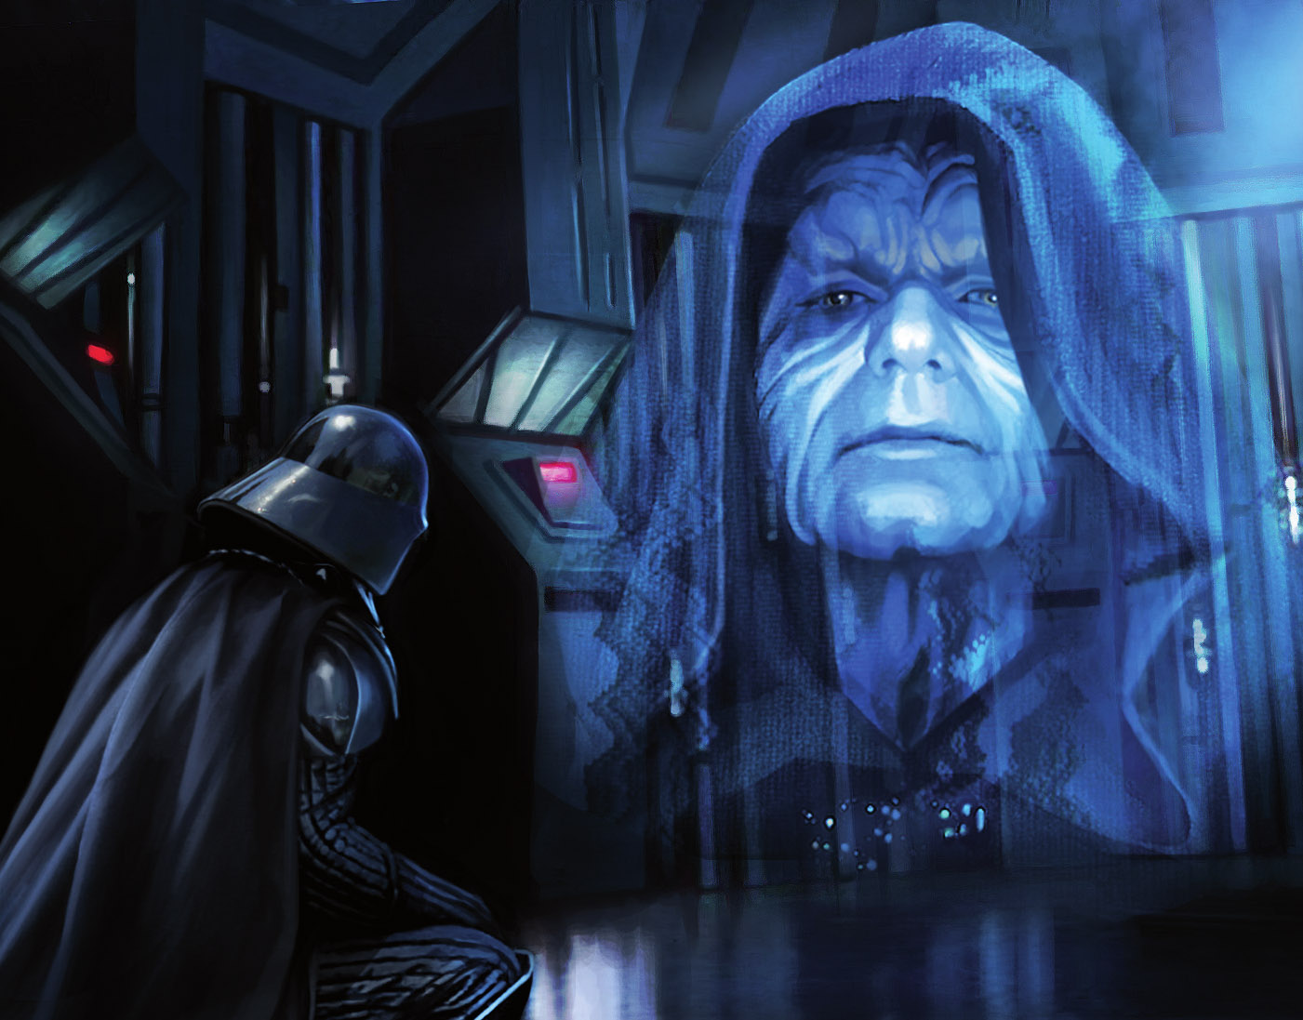
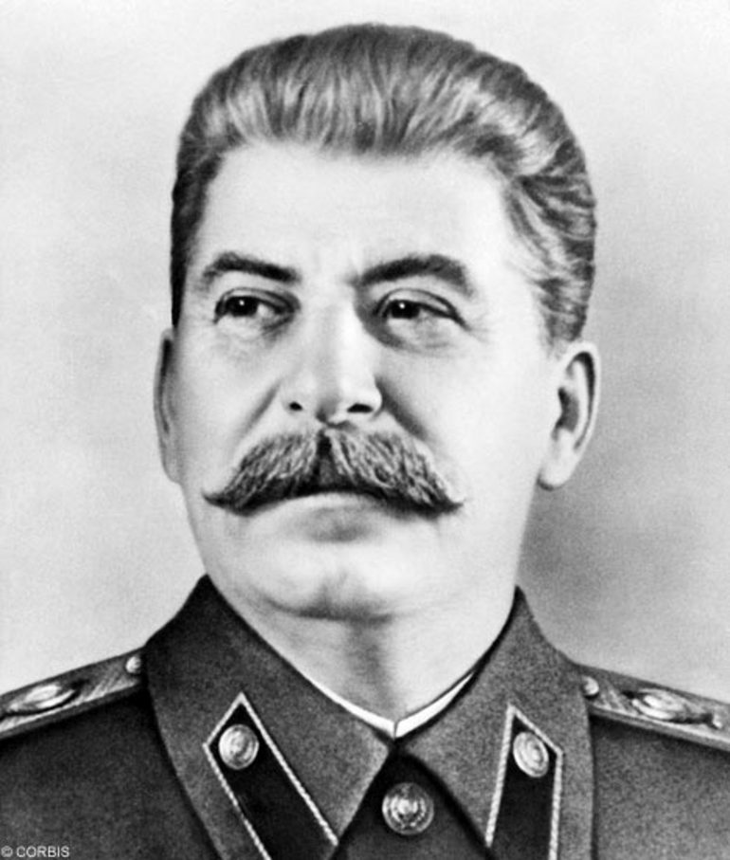
DICTATOR – someone who rules with absolute power

Slide 4
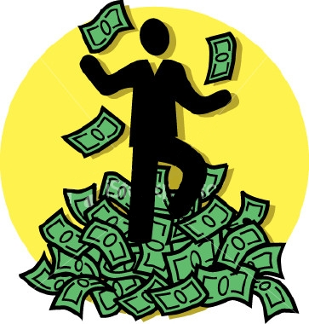
PROSPERITY – success, wealth or good fortune
OPPOSITITE OF PROSPERITY: poverty

Slide 5
PROCURE – acquire, obtain, get hold of something

