Slide 1
Climate Change
-Causes and Consequences

Slide 2
Learning Points
Understand what Climate Change is.
Understand the processes which contribute to Climate Change.
Discuss the possible impact of Climate Change on the survival of living things.

Slide 3
What is Climate Change?
Climate Change refers to changes in
the world’s atmosphere.
It includes a rise in average global
temperature and changes in rainfall,
and other weather patterns.

Slide 4
What is causing Climate Change?

Slide 5
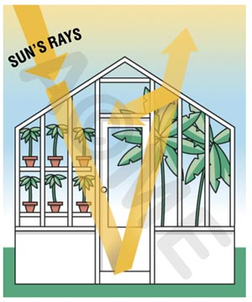
The Greenhouse Effect
At the heart of Climate Change is the GREENHOUSE EFFECT.
effetdeserretoimeme.com

Slide 6
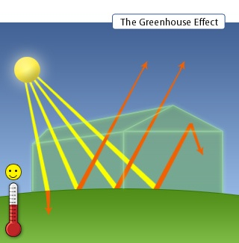
Greenhouse Effect
Greenhouses trap heat from the sun.
The glass panels let in light but keep heat from escaping.
This causes the greenhouse to heat up.
qwickstep.com

Slide 7
Greenhouse Effect
The same thing happens when a car is left in direct sunlight.
itswrong.webs.com

Slide 8
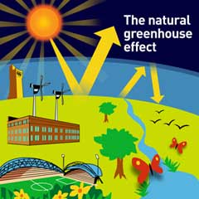
0n Earth, the atmospheric gases allow sunshine to pass through but absorb heat that is radiated (bounced) back from the warmed surface of the Earth
kirklees.gov.uk

Slide 9
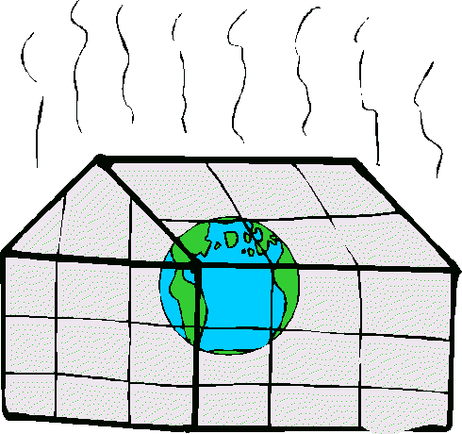
Greenhouse Effect
The gases in the atmosphere
act like a blanket around our
planet which traps in heat,
making the temperature rise.
This is called the Greenhouse
Effect and is a natural
process that keeps the planet
warm and sustains life.
If the greenhouse effect
didn’t exist, the average
temperature on earth would
be around -18ºC.
solcomhouse.com

Slide 10
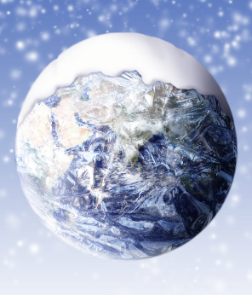
Without greenhouse gases,
heat would escape back into space and Earth’s average temperature would be about 16ºC colder...

Slide 11
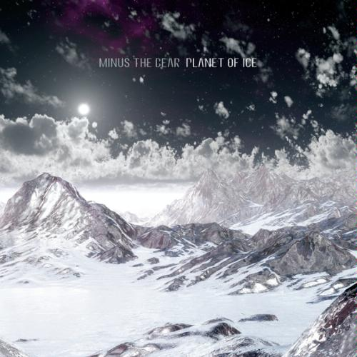
...and the Earth would not be warm enough for humans to live.

Slide 12
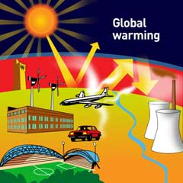
Greenhouse Effect
So what’s the problem?
The increasing amounts of greenhouse gasses released
into the atmosphere due to human activities such as
burning fossil fuels and cutting down forests is trapping
more heat so making the planet warmer than it should
be. This results in Global Warming.
kirklees.gov.uk

Slide 13
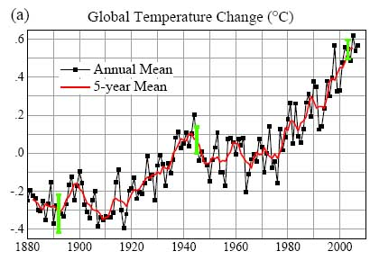
Global warming!
newscientist.com

Slide 14
Greenhouse gases
There are six greenhouse gases and it is
thought that carbon dioxide (CO₂) is one of
the most important greenhouse gas.
Water vapour
(H₂0)
Methane
(CH₄)
Ozone
(O₃)
Nitrogen dioxide
(NO₂)
Carbon dioxide
(C0₂)
Sulphur dioxide
(S0₂)

Slide 15
But where do these Greenhouse gases
come from???

Slide 16
GREENHOUSE GASES
Greenhouse gases can come from;
Natural sources
Man-Made sources

Slide 17
Natural Climate Change
Greenhouse gases occur naturally and cause the climate to change in a normal, natural way. Lets look at 4 of them.
Methane
(CH₄)
Nitrogen dioxide
(NO₂)
Carbon dioxide
(C0₂)
Sulphur dioxide
(S0₂)

Slide 18
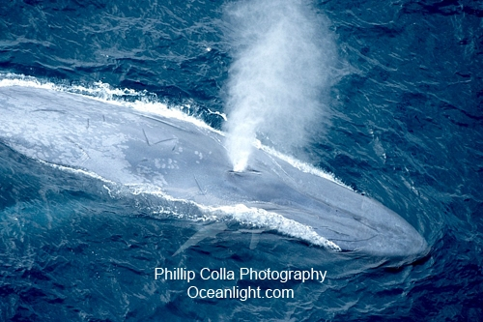
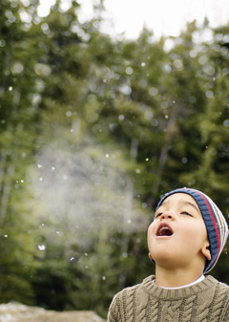
Carbon Dioxide Occurs Naturally
wondertime.go.com
Produced by living organisms through respiration
(breathing).

Slide 19
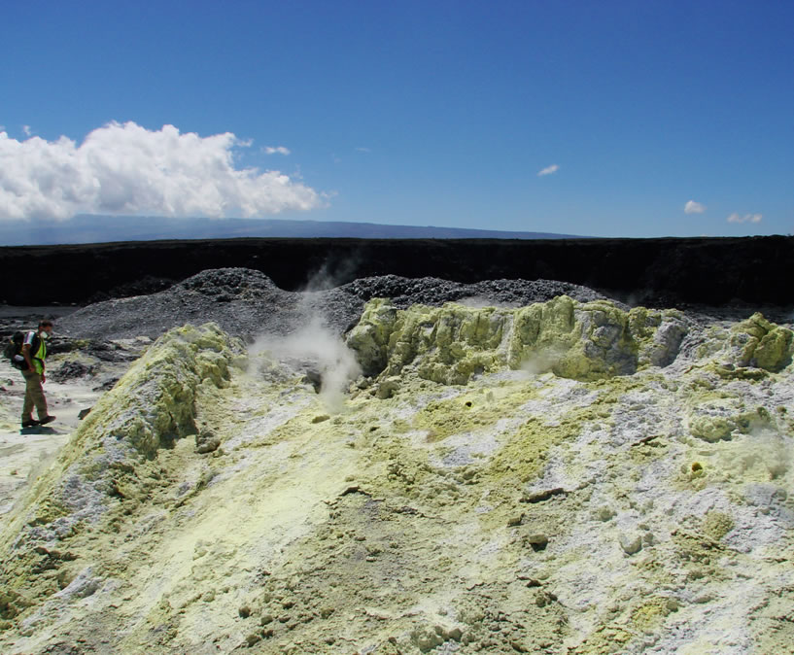
Sulphur Dioxide Occurs Naturally
geology.com
Released from volcanoes

Slide 20
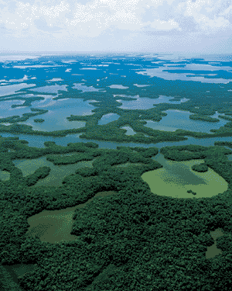
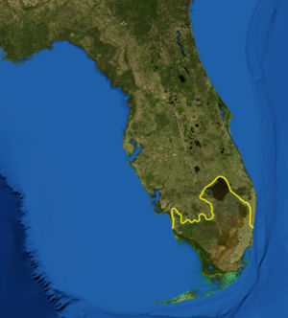
Methane Occurs Naturally
michellehenry.fr
Decomposition of organic matter (especially in wetlands).

Slide 21
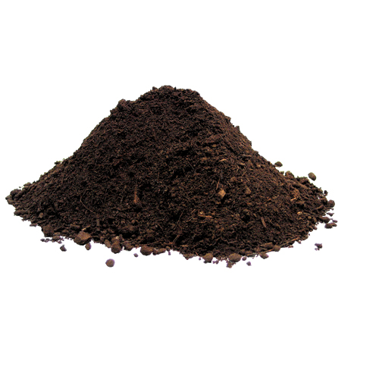
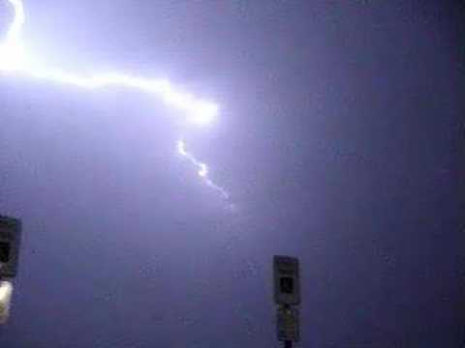
Nitrous Oxide Occurs Naturally
123rf.com
fnal.gov
From
bacteria
in soil.
During
lightning
storms.

Slide 22
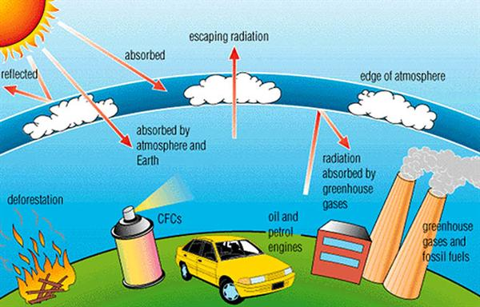
Man has increased the amount of Greenhouse gases going into the atmosphere.
Man-made Climate Change
marchantscience.wikispaces.com

Slide 23
Man-made Climate Change This increases the Greenhouse Effect.
marchantscience.wikispaces.com

Slide 24
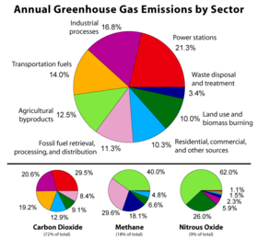
Man-made sources of extra
Greenhouse gases
squidoo.com

Slide 25
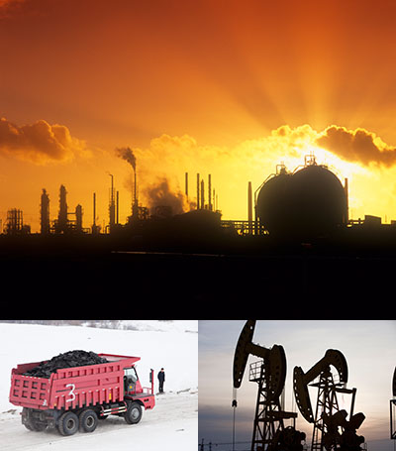
Man-made Sources of
Carbon Dioxide
globalwarmingimages.net
Burning of solid waste, wood, and fossil fuels (oil, natural gas, and coal).

Slide 26
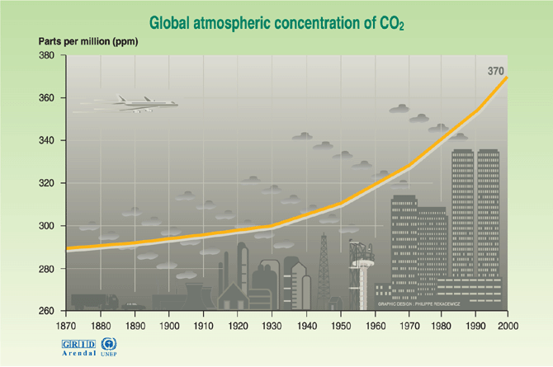
Carbon dioxide concentrations have been on the rise since the industrial revolution
grida.no

Slide 27
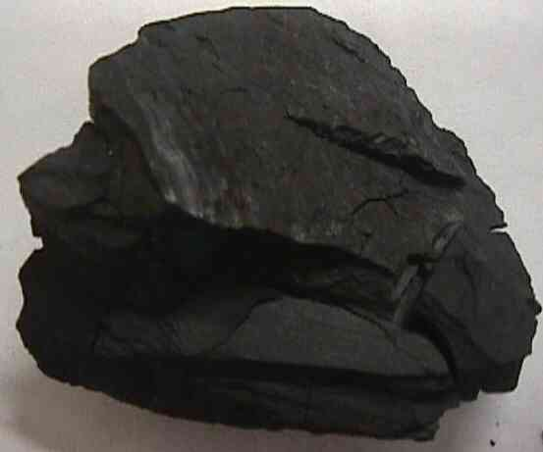
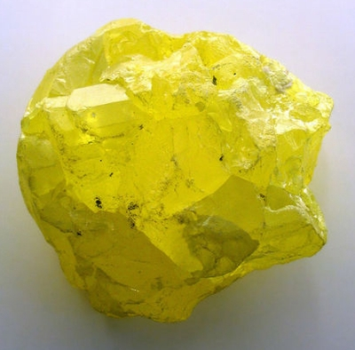
Man-made sources of Sulphur dioxide
A lump of coal might look like it only contains carbon, but there is an impurity hidden in within it.
mii.org
Sulphur is found in most fossil fuels and is a problem when it burns it forms sulphur dioxide.
hertenberger.co.za

Slide 28
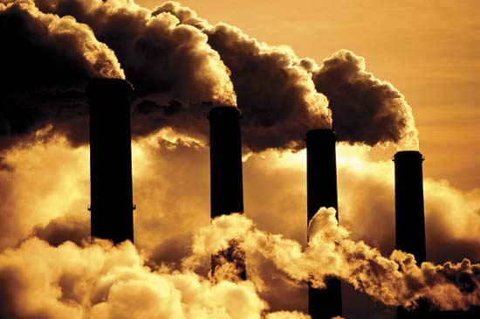
Man-made Sources of Nitrous Oxide
Agricultural and industrial processes
gosolarenergyforlife.com

Slide 29
Car Engines
Man-made Sources of Nitrous Oxide
The spark plug in the car engine causes the nitrogen and oxygen in the air to react together.

Slide 30
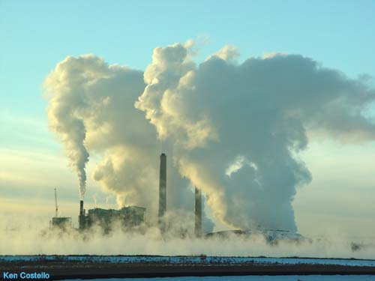
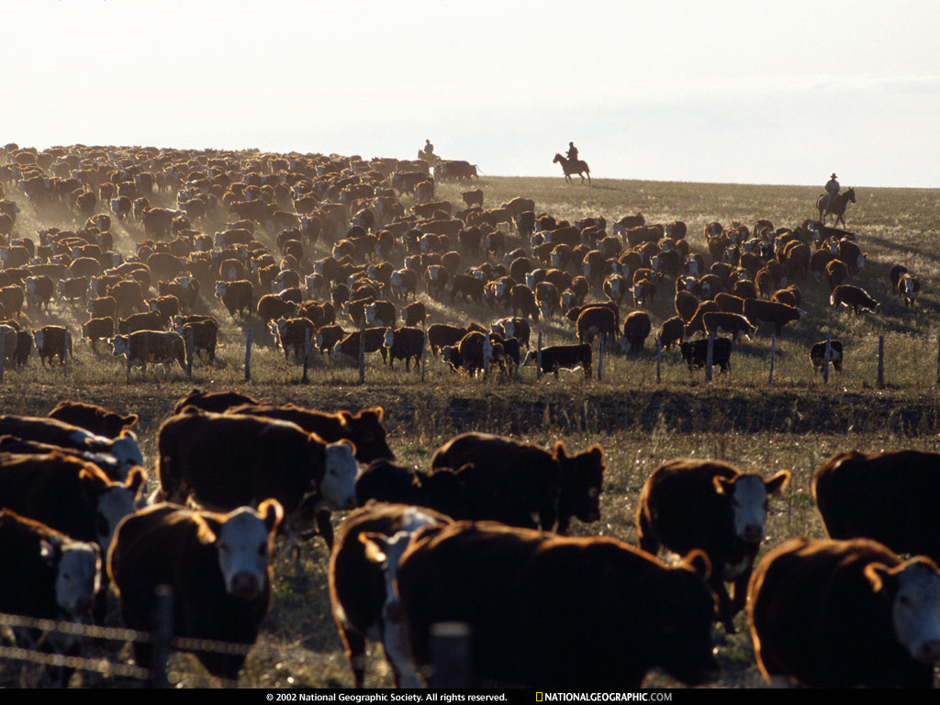
Man-made Sources of Methane
Production and transport of fossil fuels
Decomposition of organic waste (landfills/livestock farming)
DID YOU KNOW...Ruminants belch tremendous amounts of methane (and other greenhouse gases)
BURP
‘CH₄’
BURP
‘CH₄’
BURP
‘CH₄’
BURP
‘CH₄’
BURP
‘CH₄’
BURP
‘CH₄’
BURP
‘CH₄’
BURP
‘CH₄’
BURP
‘CH₄’
BURP
‘CH₄’
BURP
‘CH₄’
BURP
‘CH₄’
BURP
‘CH₄’
BURP
‘CH₄’
BURP
‘CH₄’
BURP
‘CH₄’
BURP
‘CH₄’

Slide 31
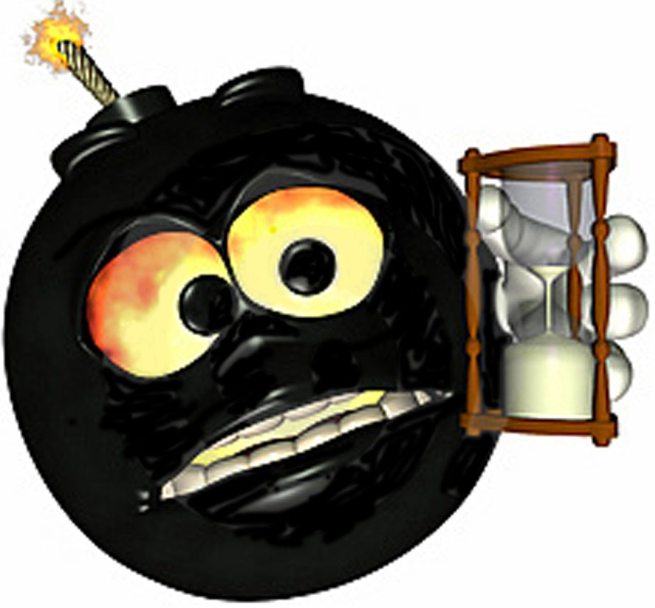
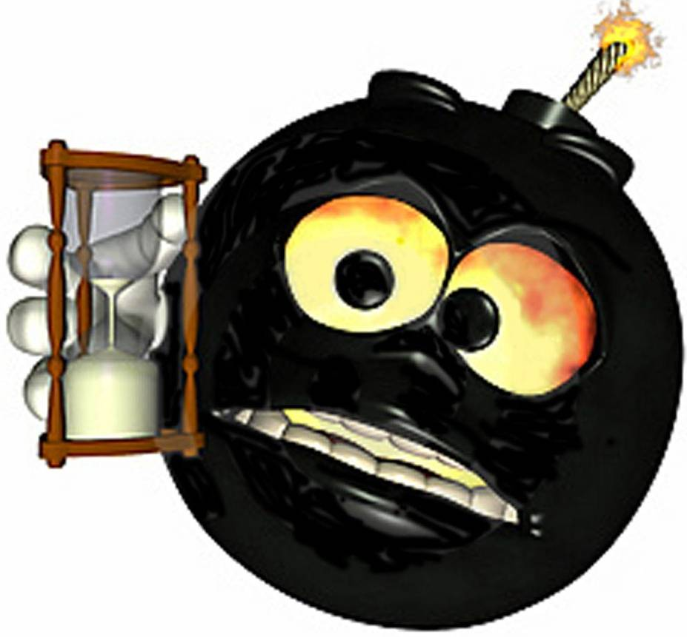
bajan.wordpress.com
Climate scientists have been concerned about a so-called “methane time bomb”…
…set off when warming Arctic temperatures melt permafrost and cause
frozen vegetation in peat bogs
and other areas to decay,
releasing methane
and carbon dioxide.
Now come fears of a methane time bomb, part two…
…this one a result of melting of the sub-sea layer of permafrost which will release methane deposits formed before the last ice age.
bajan.wordpress.com

Slide 32
CH₄
More atmospheric methane
Causes higher temperatures
Leading to further permafrost melting
And the release of yet more methane
And it keeps going, and going…
Tipping Point
Methane is about 20 times more powerful as a greenhouse gas than carbon dioxide.
Scientists fear that its release could accelerate global warming in a giant positive feedback.

Slide 33
The effects of out of control
Climate Change

Slide 34
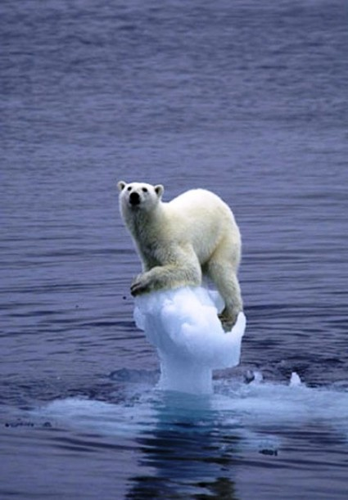
If the greenhouse effect becomes stronger, it could make the Earth warmer than usual.
Even a little extra warming may cause problems for humans, plants, and animals.
freakyweather.com

Slide 35
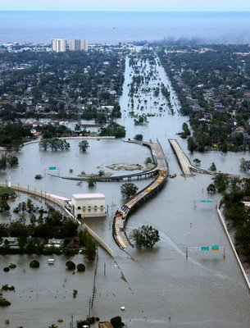
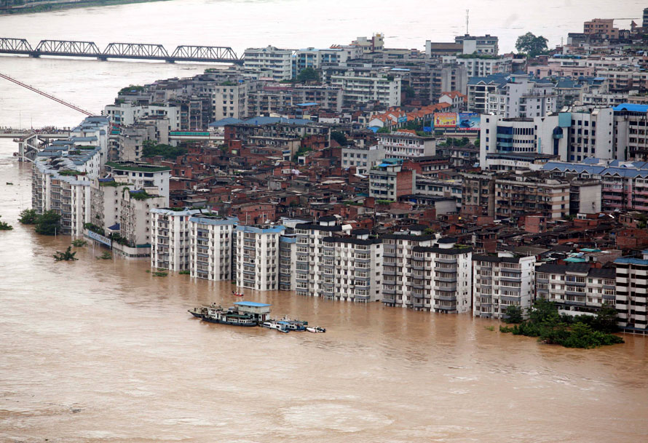
What if the Earth heats up?
Sea levels around the world could rise.
Cities on coasts would flooding.
lilithnews.com
sinostand.com

Slide 36
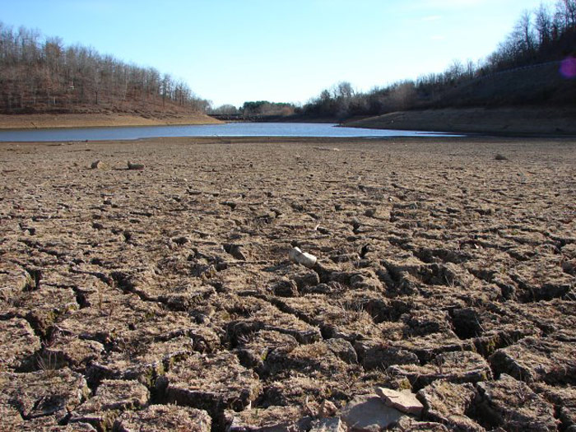
What if the Earth heats up?
Temperate places that now receive frequent
rain and snowfall might become hotter and
drier, leading to more drought.
serc.carleton.edu

Slide 37
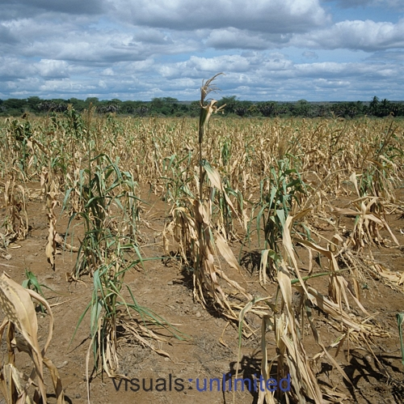
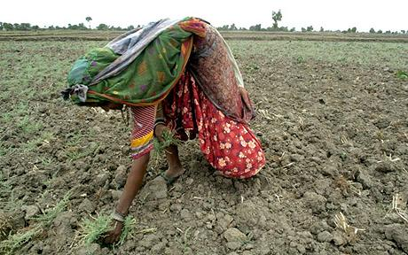
What if the Earth heats up?
Frequent periods of drought would make
it hard to raise crops for food, leading to
famine.
photoshelter.com
jamblichus.wordpress.com

Slide 38
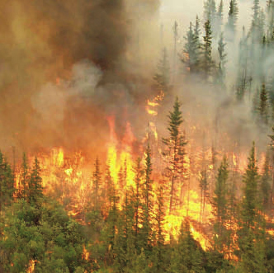
What if the Earth heats up?
Forest fires could occur more often.
blogs.canoe.ca

Slide 39
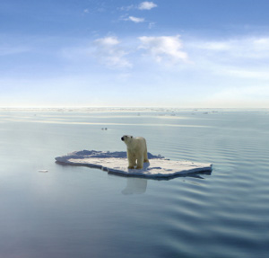
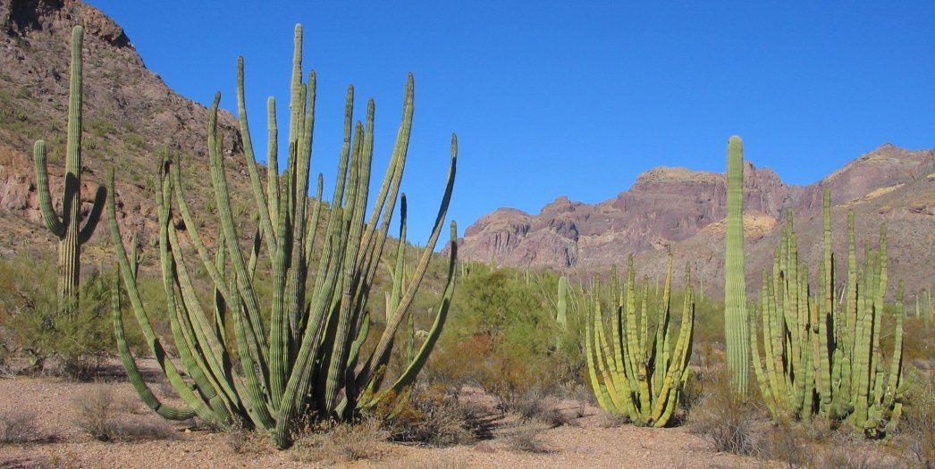
What if the Earth heats up?
Plants and animals unable to take the heat
may go extinct, and be replaced by heat
tolerant species.
neutralexistence.com
saddleridgeva.com

Slide 40
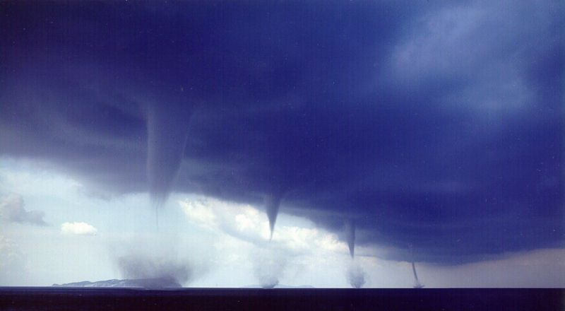
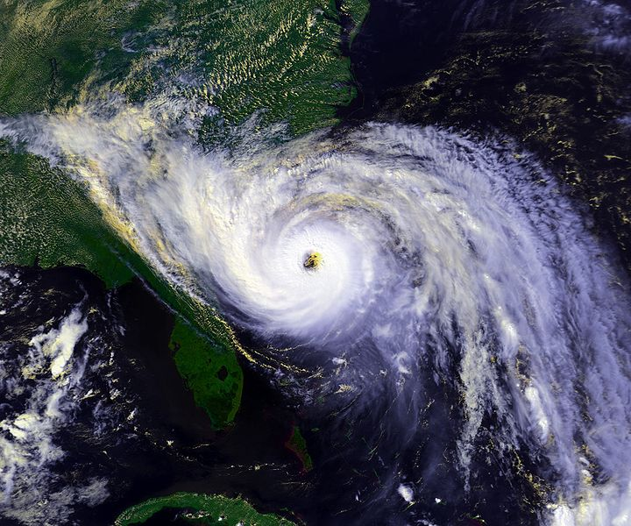
What if the Earth heats up?
Hurricanes, tornadoes and other storms
caused by changes in heat and water
evaporation might occur more frequently
and be more intense.
pantherfile.uwm.edu
ownthedollar.com

Slide 41
The effects of Climate Change
In the UK, we expect that because of climate change:
Temperatures will increase.
Winter rainfall will get heavier, increasing
the risk of flooding.
kirklees.gov.uk

Slide 42
The effects of Climate Change
Summer rainfall in the UK may reduce considerably,
creating pressure on water resources.
Sea levels will rise due to melting ice caps, leading
to further coastal erosion and flood risk.
kirklees.gov.uk

Slide 43
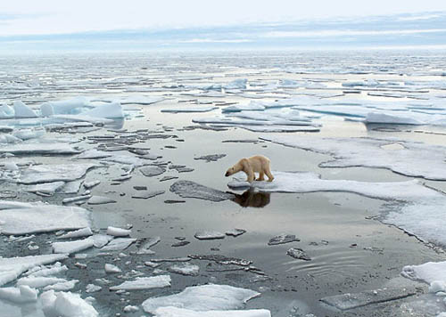
What is happening in the Arctic is a "tipping point”
Scientists worry that climate change is progressing so rapidly that, within decades, humans may be helpless to slow or reverse the trend.
There is a threshold where a slight rise in the Earth's temperature can cause a dramatic change in the environment that itself triggers a far greater increase in global temperatures.
This is the ‘tipping point’ beyond which really dangerous climate change is likely to be unstoppable.

